Slide 1
PERSIAN GULF
VFR
DEPARTURE AND RECOVERY ROUTES

Slide 2
AL AIN VFR DEPARTURE ROUTES
6000
Village
073˚
113˚
6000
4500
Circles
T-junction
002˚
OMAL
185˚
3300
048˚
Field
120˚
5000
Roads
RWY 01 (VILLAGE)
Fly 002˚ to 4500’ by 9.7nm, then climb 073˚ to be at or above 6000’ at VILLAGE.
RWY 19 (ROADS)
Fly 185˚ to 3300’ by 6.5nm, then climb 120˚ to be at or above 6000’ at ROADS.
RWY 01 (CIRCLES)
Fly 002˚ to 4500’ by 9.7nm, then climb 113˚ to be at or above 6000’ at CIRCLES.
RWY 19 (CIRCLES)
Fly 185˚ to 3300’ by 6.5nm, then climb 048˚ to be at or above 6000’ at CIRCLES.

Slide 3
AL AIN VFR RECOVERY ROUTES
4000
5000
Village
253˚
294˚
4000
5000
3500
Circles
T-junction
182˚
OMAL
006˚
OVERHEAD RWY 01 (CIRCLES)
Intercept CIRCLES between 4000’ and 5000’ outbound 228˚ , right turn to 006˚ at FIELD leveling out at 2300’ for a LEFT BREAK.
2300
228˚
Field
300˚
3000
4000
OVERHEAD RWY 01 (ROADS)
Intercept ROADS between 3000’ and 4000’ outbound 300˚ , right turn to 006˚ at FIELD leveling out at 2300’ for a LEFT BREAK.
Roads
OVERHEAD RWY 19 (CIRCLES)
Intercept CIRCLES between 4000’ and 5000’ outbound 294˚ , left turn to 182˚ at T-JUNCTION below 3500’, descend to 2300’ for a RIGHT BREAK.
STRAIGHT IN RWY 01
From FIELD, follow glideslope.
OVERHEAD RWY 19 (VILLAGE)
Intercept VILLAGE between 4000’ and 5000’ outbound 253˚ , left turn to 182˚ at T-JUNCTION below 3500’, descend to 2300’ for a RIGHT BREAK.
STRAIGHT IN RWY 19
From T-JUNCTION, follow glideslope.

Slide 4
AL AIN VFR DEPARTURE ROUTES
6000
Village
073˚
113˚
6000
4500
Circles
T-junction
002˚
OMAL
185˚
3300
048˚
Field
120˚
5000
Roads
RWY 01 (VILLAGE)
Fly 002˚ to 4500’ by 9.7nm, then climb 073˚ to be at or above 6000’ at VILLAGE.
RWY 19 (ROADS)
Fly 185˚ to 3300’ by 6.5nm, then climb 120˚ to be at or above 6000’ at ROADS.
RWY 01 (CIRCLES)
Fly 002˚ to 4500’ by 9.7nm, then climb 113˚ to be at or above 6000’ at CIRCLES.
RWY 19 (CIRCLES)
Fly 185˚ to 3300’ by 6.5nm, then climb 048˚ to be at or above 6000’ at CIRCLES.

Slide 5
AL AIN VFR RECOVERY ROUTES
4000
5000
Village
253˚
294˚
4000
5000
3500
Circles
T-junction
182˚
OMAL
006˚
OVERHEAD RWY 01 (CIRCLES)
Intercept CIRCLES between 4000’ and 5000’ outbound 228˚ , right turn to 006˚ at FIELD leveling out at 2300’ for a LEFT BREAK.
2300
228˚
Field
300˚
3000
4000
OVERHEAD RWY 01 (ROADS)
Intercept ROADS between 3000’ and 4000’ outbound 300˚ , right turn to 006˚ at FIELD leveling out at 2300’ for a LEFT BREAK.
Roads
OVERHEAD RWY 19 (CIRCLES)
Intercept CIRCLES between 4000’ and 5000’ outbound 294˚ , left turn to 182˚ at T-JUNCTION below 3500’, descend to 2300’ for a RIGHT BREAK.
STRAIGHT IN RWY 01
From FIELD, follow glideslope.
OVERHEAD RWY 19 (VILLAGE)
Intercept VILLAGE between 4000’ and 5000’ outbound 253˚ , left turn to 182˚ at T-JUNCTION below 3500’, descend to 2300’ for a RIGHT BREAK.
STRAIGHT IN RWY 19
From T-JUNCTION, follow glideslope.

Slide 6
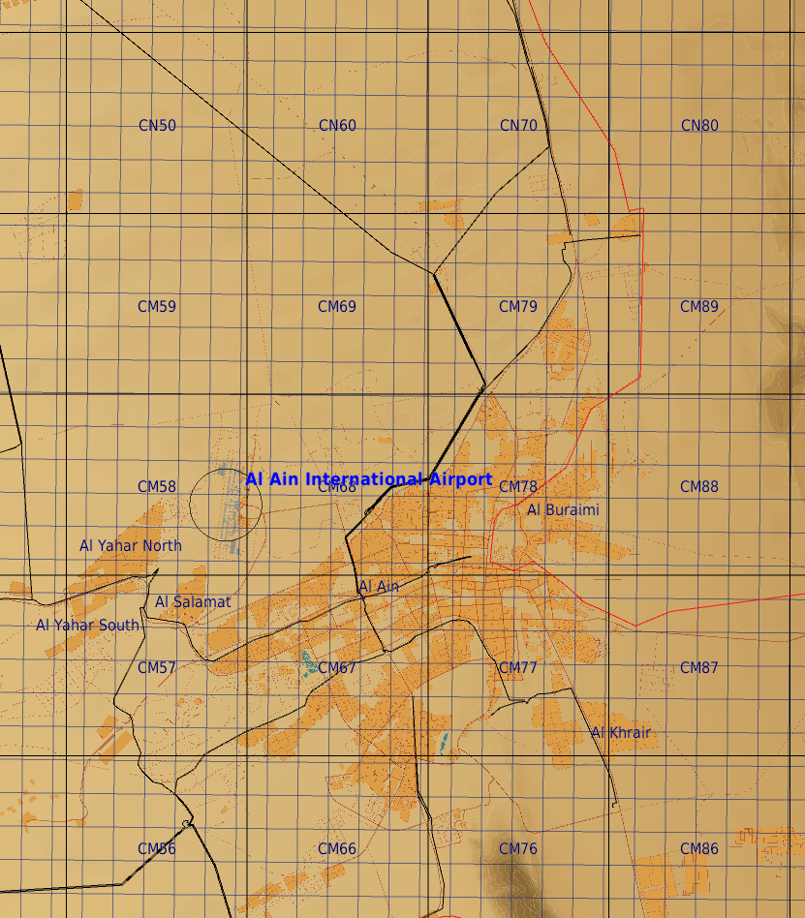
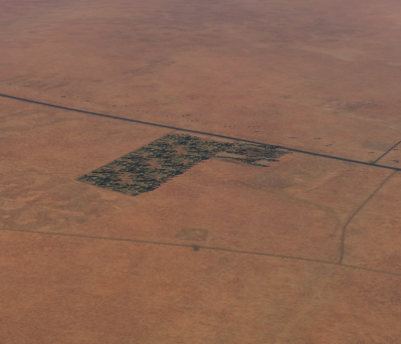
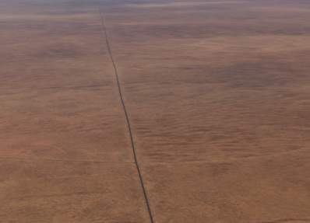
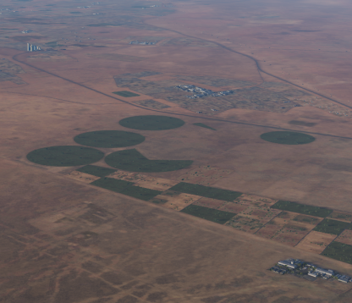
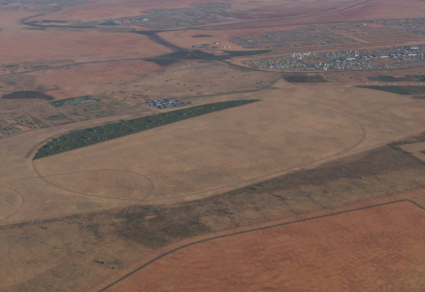
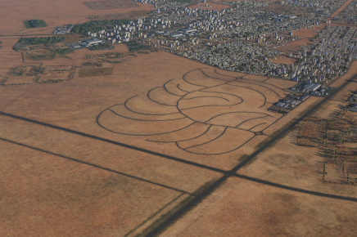
Village
T-junction
Circles
Field
Roads

Slide 7
AL DAHFRA VFR DEPARTURE ROUTES
Al Gurm
6000
Eyeball
6000
336˚
6000
286˚
1500
268˚
Hexx
Harbour
308˚
OMAM
6000
6000
X-Junction
128˚
Lake
1500
058˚
Racetrack
096˚
6000
Village
RWY 31R (MANSA-1)
Fly 308˚ to 1500’ by 6nm, then climb 336˚ to be at or above 6000’ at Al Gurm.
RWY 13L (LUGAL-1)
Fly 128˚ to 1500’ by 6nm, then climb 058˚ to be at or above 6000’ at Lake. Continue own navigation from Lake.
RWY 31R (MANSA-2)
Fly 308˚ to 1500’ by 6nm, then climb 286˚ to be at or above 6000’ at Eyeball.
RWY 13L (LUGAL-2)
Fly 128˚ to 1500’ by 6nm, then climb 096˚ to be at or above 6000’ at Village. Continue at or above 6000’ to X-junction.
RWY 31R (MANSA-3)
Fly 308˚ to 1500’ by 6nm, then climb 268˚ to be at or above 6000’ at Hexx.
RWY 13L (LUGAL-3)
Fly 128˚ to 1500’ by 6nm, then climb 096˚ to be at or above 6000’ at Village.

Slide 8
AL DAHFRA VFR DEPARTURE ROUTES
AL GURM
6000
EYEBALL
6000
336˚
6000
286˚
2000
268˚
HEXX
HARBOUR
308˚
OMAM
6000
6000
X-JUNCTION
128˚
Lake
2000
058˚
RACETRACK
096˚
6000
VILLAGE
RWY 31R (MANSA-1)
Fly 308˚ to 2000’ by 6nm, then climb 336˚ to be at or above 6000’ at AL GURM.
RWY 13L (LUGAL-1)
Fly 128˚ to 2000’ by 6nm, then climb 058˚ to be at or above 6000’ at LAKE. Continue own navigation from LAKE.
RWY 31R (MANSA-2)
Fly 308˚ to 2000’ by 6nm, then climb 286˚ to be at or above 6000’ at EYEBALL
RWY 13L (LUGAL-2)
Fly 128˚ to 2000’ by 6nm, then climb 058˚ to be at or above 6000’ at LAKE. Continue at or above 6000’ to X-JUNCTION.
RWY 31R (MANSA-3)
Fly 308˚ to 2000’ by 6nm, then climb 268˚ to be at or above 6000’ at HEXX.
RWY 13L (LUGAL-3)
Fly 128˚ to 2000’ by 6nm, then climb 096˚ to be at or above 6000’ at VILLAGE.

Slide 9
AL DAHFRA VFR RECOVERY ROUTES
AL GURM
5000
3000
5000
3000
EYEBALL
156˚
5000
3000
100˚
1500
088˚
5000
3000
HEXX
HARBOUR
128˚
OMAM
5000
3000
X-JUNCTION
308˚
Lake
1500
238˚
5000
3000
RACETRACK
276˚
VILLAGE
RWY 13L (MALIK-1)
Enter AL GURM between 5000ft and 3000ft, descend to 1500ft at HARBOUR.
Then Straight-in or Overhead break.
RWY 31R (LAMANE-1)
Enter LAKE between 5000ft and 3000ft, descend to 1500ft at RACETRACK.
Then Straight-in or Overhead break.
RWY 13L (MALIK-2)
Enter EYEBALL between 5000ft and 3000ft, descend to 1500ft at HARBOUR.
Then Straight-in or Overhead break.
RWY 31R (LAMANE-2)
Enter X-JUNCTION between 5000ft and 3000ft,cross LAKE between 5000ft and 3000ft descend to 1500ft at RACETRACK.
Then Straight-in or Overhead break.
RWY 13L (MALIK-3)
Enter HEXX between 5000ft and 3000ft, descend to 1500ft at HARBOUR.
Then Straight-in or Overhead break.
RWY 31R (LAMANE-3)
Enter VILLAGE between 5000ft and 3000ft, descend to 1500ft at RACETRACK.
Then Straight-in or Overhead break.

Slide 10
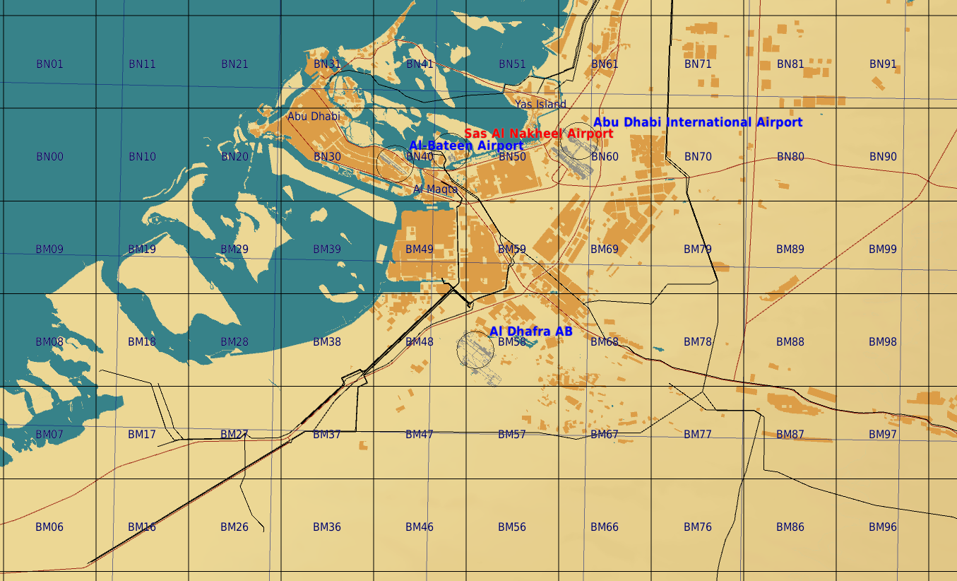
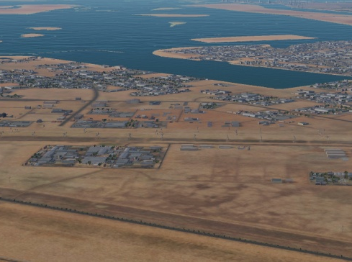
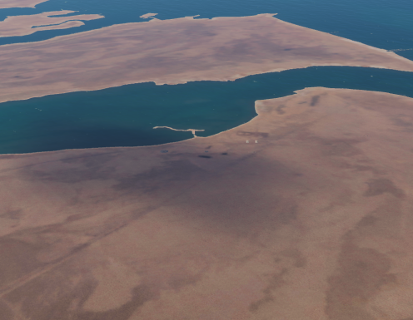
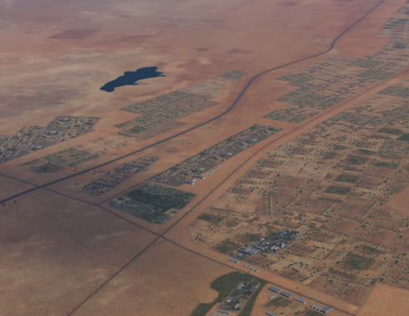
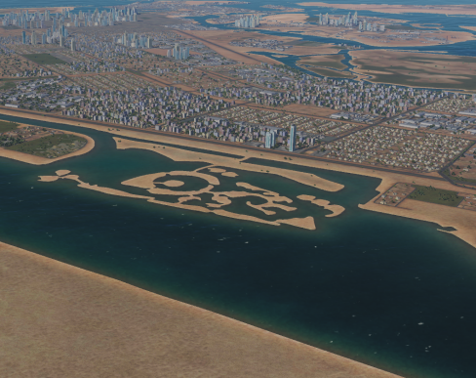
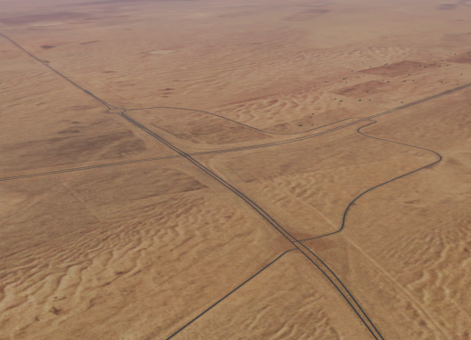
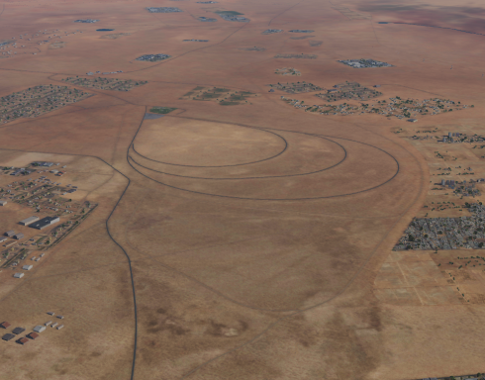
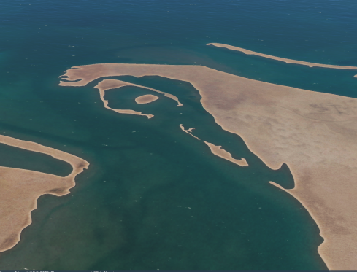
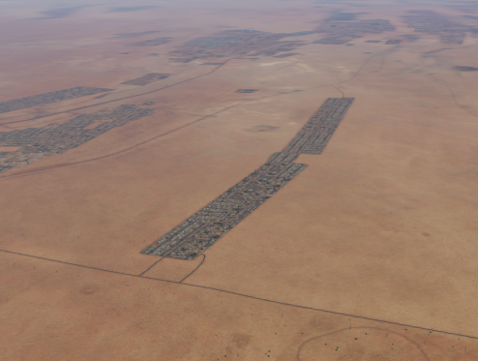
Al Gurm
Eyeball
Harbour
Lake
X-Ray junction
Hexx
Racetrack
Village
Harbour
Hexx
Lake
Al Gurm
X-Ray junction
Racetrack
Eyeball
Village

